Slide 1
The Ages of Globalization: Geography, Technology, and Institutions
Jeffrey D. Sachs (2020) Published by: Columbia University

Slide 2
Introduction
The preface launches the idea of the book from the current global pandemic of Covid-19, looking back to earlier global threats that have impacted human life and the planet Earth.
In just three months, the virus spread from Wuhan, China, to more than 140 other countries. In the fourteenth century, the bubonic plague spread the Black Death from China to Italy in the course of some sixteen years, 1331 to 1347. In our time, the pathogen arrived within days by nonstop flight from Wuhan to Rome.
I savor my morning coffee, which arrives not from the coffee shop across the street but from the sloping tropical hillsides of Ethiopia, Indonesia, and Colombia, thousands of miles away.
The Europeans brought horses, cattle, and other plants and animals to the Americas for farming, and also many new infectious diseases, including smallpox, measles, and malaria, while bringing back to Europe the cultivation of the potato, maize, tomatoes, and other crops and farm animals. This “Columbian Exchange” united the world in trade while dividing the world in new kinds of inequalities of wealth and power.
Until late in the nineteenth century, Africa’s heavy burden of malaria created a kind of protective barrier against European imperial conquest. West Africa was known as the “white man’s grave,” since European soldiers succumbed in such high proportions to malaria.

Slide 3
Introduction
Trade is beneficial but spread of diseases is threat. Humans found the solution as follows: The fight against pandemic disease has loomed large in the efforts at cooperation. Indeed, the International Sanitary Conferences that began in 1851 and continued until 1938 were among the first modern efforts at intensive global scientific and policy cooperation. These efforts at disease control gave rise to the World Health Organization in 1948, one of the first major agencies of the new United Nations, which was founded at the end of World War II in 1945.
The complex connections between global developments, improvements, and threats clarify the urgency of seeking better ways to deal with global crises.
The subtext of The Ages of Globalization is a humanitarian concern for human life and the planet Earth. Sachs’ ethos is clear at the outset: human kindness must be the basis for human interactions, bearing in mind the complex material conditions and diversity of global cultures.

Slide 4
Seven Ages of Globalization (pp. 1-32)
Humanity has always been globalized, since the dispersals of modern humans from Africa some seventy thousand years ago. Yet globalization has changed its character from age to age. Those changes have often come quickly and violently.
In the twenty-first century, we need to change peacefully and wisely; in the nuclear age, there may be no second chances in the event of global war. By studying the history of globalization, we can arrive at an informed understanding of globalization in the twenty-first century and how to manage it successfully. In my interpretation, we have passed through seven distinct ages of globalization...

Slide 5
Seven Ages of Globalization (pp. 1-32)
Let us keep our eye on five big questions. First, what have been the main drivers of global-scale change? Second, how do geography, technology, and institutions interact? Third, how do changes in one region diffuse to others? Fourth, how have these changes affected global interdependence? Fifth, what lessons can we glean from each age to help us meet our challenges today?

Slide 6
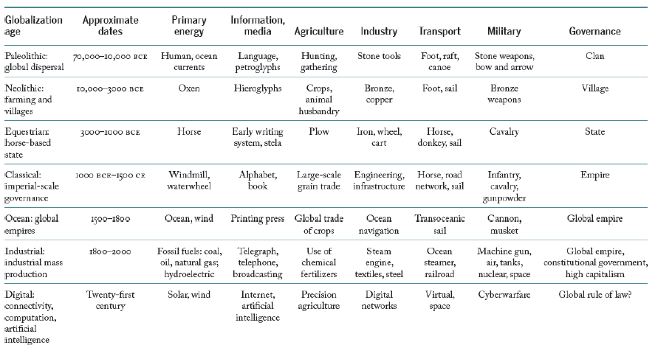
Table 1.1 Ages of Globalization: Dates and Breakthroughs

Slide 7
The Acceleration of Change
At the dawn of human history, all humans were foragers, engaged in hunting and gathering food for their survival. There was no urban rural divide, as there were no villages, much less cities. The Neolithic revolution in agriculture gave rise to farm villages and sedentary life, mostly (but not completely) displacing foraging and nomadism.
Humans hardly save and they were extremely vulnerable to famines. These famines led war/revolution. The concept of surplus came in the industrial era. Farm machines increased output per person and surplus labour freed for migration to cities. TM
The first lesson of long-term global change, then, is that it has been super-exponential, meaning that it has come at a rising rate, with the largest changes occurring in the very recent past.
There are 3 dimensions of long-term change: total population, urbanization and output per person. TM

Slide 8
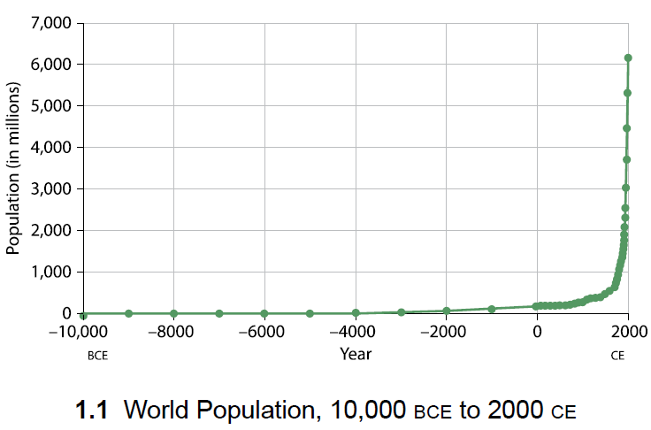
World Population, 10,000 BCE to 2000 CE

Slide 9
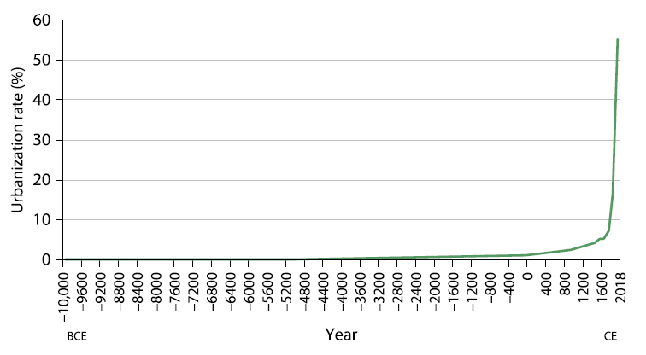
World Rate of Urbanization, 10,000 BCE to Present

Slide 10
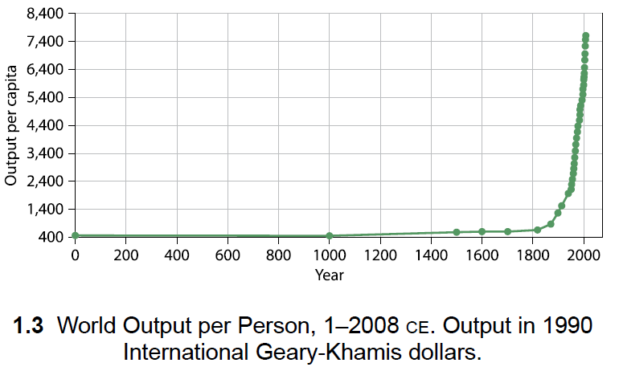
World Output per person

Slide 11
The Acceleration of Change (Super-exponential growth )
These three cases of super-exponential growth are dramatic. They remind us of the dramatic changes in the world since the onset of industrialization.
Yet we should not infer that societies were static before 1800. The long period until the start of industrialization was an active and necessary runway for the eventual liftoff of the world economy.
The preceding ages of globalization set the essential foundations of science, technology, governance, commercial law, and sheer ambition that ultimately gave rise to the Industrial Age.

Slide 12
Economic Scale and the Pace of Change
There is a basic idea in economics that a larger market leads to higher incomes and more rapid growth. It leads to more specialization, efficiency and lower cost.
It creates incentive for innovations.
The most fundamental reason for the takeoff of economic growth around 1800 is therefore scale.
Yet the scale of global enterprise by 1800 was
incomparably larger (one billion populaiton) than, say, in 10,000 BCE, when an estimated 2million widely-dispersed human beings constituted the entirety of humanity.
One can therefore see the history of globalization as a series of scale-enlarging transformations.

Slide 13
Economic Scale and the Pace of Change
In this sense, the ages of globalization both explain and are explained by the rising scale of global interactions. Each boost in global scale has given rise to new technologies that have expanded populations and production. Each boost of scale, in turn, has changed the nature of governance and geopolitics.
While scale is crucial for productivity and innovation, geography is often decisive in determining scale. The scale of an economy, or a group of interconnected economies, depends on the ability to trade, and therefore on the geographic conditions for the movement of goods, people, and ideas. Places that are remote or isolated will not benefit as much from trade and the diffusion of ideas and technologies as places that are more accessible.

Slide 14
Malthusian Pessimism
Malthus famously warned against trying to improve the lot of the poor, and even against the chances for long-term economic progress. He argued that following any rise in productivity, the world would simply end up with more poor people, but with no long-term solution to poverty.
Here is Malthus’s reasoning. Suppose that farmers learned to double their output. It would seem that everybody could eat twice as much, and that hunger and poverty would plummet. But what if the population were to increase as a result, as more children survived to adulthood and more young people could afford to start families? If the population doubled while the farmland remained unchanged, the amount of food per person would be back where it started. And if the population were to more than double—that is, if the population were to overshoot—then living standards could actually fall below the starting point, until new bouts of hunger and disease reversed the overshooting.
Matlhus was wrong as well as he was right. The concept of quality children as well as poverty/hunger still threat for the planet.

Slide 15
The Gradual Transformation to Urban Life
Across the ages of globalization, we have seen not only an increase in scale—of the human population, of economic production, and of politics—but also a decisive shift from rural to urban life.
To understand this change, we should examine in more detail the structure of an economy.
Economic activities are usefully categorized into three productive sectors, called the primary, secondary, and tertiary sectors.

Slide 16
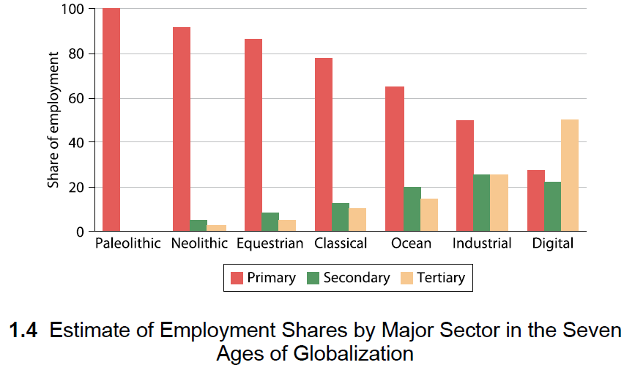
Employment Shares

Slide 17
The Interplay of Geography, Technology, and Institutions
The economic system of any time and place rests on three foundations: geography, technology, and institutions.
Consider the example of coal-burning steam engine, the most important invention of the industrial age. Geography (coal abundance in UK). Watt’s ingenuity and skill as a craftsman (technology)
Watt patented his invention and successfully defended his patents from those who tried to cash in on his invention (Institutions).
Moreover, industrialists purchased and deployed Watt’s steam engines because they could readily establish their own companies under British law.
Clearly this debate is misguided (Isolated importance of any of these 3). The industrial revolution emerged as a result of the interaction of geography, technology, and institutions.

Slide 18
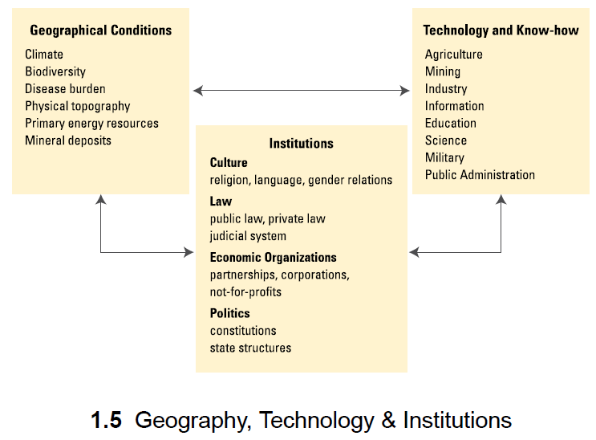
The Interplay of Geography, Technology, and Institutions

Slide 19
The Interplay of Geography,,
These geographical factors must be considered in light of existing technologies. An economy depends both on its physical resource base and on the know-how to use those natural resources. Since each age of globalization has been characterized by advances in know-how, the implications of geography have changed along with the advances of knowledge. The great grasslands of the steppe region meant a lot more after the domestication of the horse than before. The presence of coal and oil reserves meant a lot more after the invention of the steam engine and the internal combustion engine, respectively. The intense sunshine of the deserts will mean a lot more in the future with the deployment of low-cost photovoltaic energy.

Slide 20
Geopolitics and Globalization
Since the great dispersal from Africa, and surely before that within Africa, human groups have battled each other for territory and to secure their basic survival needs (including water, food supplies, shelter, and minerals). Indeed, human nature was forged in the cauldron of territorial competition, which instilled in our genes and our cultures a remarkable capacity to cooperate within a group, combined with a deeply rooted tendency toward conflict and distrust between groups.
One of the crucial links among geography, technology, and institutions is the interplay of military technology with physical geography and political institutions.

Slide 21
Looking Back to See Forward
Yet we cannot afford another global war.
With that in mind, I want us to consider three great issues for our time as we use our backward gaze at history to gain insights for the future. First, can the world choose a path of shared prosperity, social inclusion, and environmental sustainability in this seventh age of globalization? We can call this the challenge of sustainable development.
Second, how should our global governance be organized if, as seems likely, the Anglo-American age has ended and we are now in a truly multipolar world? We can call this the challenge of multilateral governance.
Third, is global peace possible, and if so, on what model of human understanding and ethics could this be accomplished? We can call this the challenge of universal values.

Slide 22
1 The Paleolithic Age (70,000–10,000 BCE) (pp. 33-40)
Old stone age
Our species, Homo sapiens, traces its evolutionary past to around 6 million years ago in Africa, when our ancestral line of great apes diverged into two branches, one that would evolve into modern humans and the other that would evolve into modern chimpanzees and bonobos.
The human genus Homo emerged around 4 million years ago, when humanity’s biological ancestors began to walk on two feet. The first great dispersal of hominins from Africa occurred around 2 million years ago, or even earlier, when an early Homo species left Africa for Europe and Asia.
During Paleolithic Age, small groups of humans migrated from one place to another. As they carried their tools, knowhow, and emerging cultures throughout the world, they adapted to hugely diverse habitats while causing environmental upheaval along the way.
Notes:
There is a typo for 110 in the book.

Slide 23
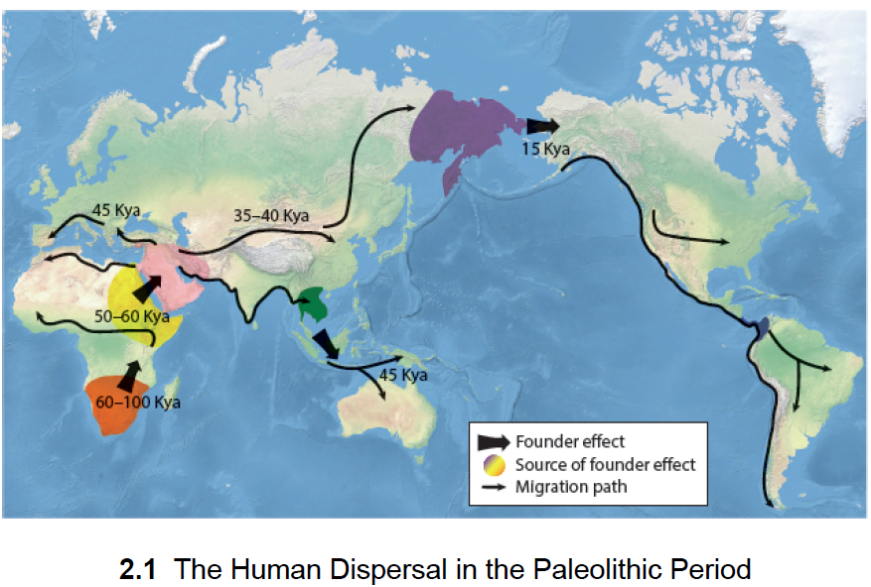
1 The Paleolithic Age
Figure 2.1 summarizes one recent theory of the Great Dispersal from Africa. It shows the estimated timing of the arrival of the modern human species in the Near East 60-60 Kya (thousand years ago), in Europe and Australasia around 45 Kya, and in the Americas around 15 Kya.

Slide 24
1 The Paleolithic Age
When humanity arrived in Australia around 45 Kya, the newly arrived foragers soon hunted to extinction many of the megafauna—the large animals weighing more than 44 kilograms.5 Around 85 percent of the continent’s large mammals went extinct soon after the arrival of humans, as did a number of birds and reptiles. It is currently debated whether these extinctions were caused solely by overkill by humans or rather by a mix of hunting and climate change.
Recent evidence puts the blame largely, if not entirely, on overkill by hunters.
In the Americas, the same thing occurred roughly 33,000 years later. The arrival of foragers across Beringia contributed to the extinction of the woolly mammoth, the mastodon, the Shasta ground sloth, the saber-toothed cat, and most consequentially, the wild horse.
The extinction of the wild horse was a devastating blow for the Amerindian populations.
The next time the native populations encountered the horse was with the arrival of European conquerors on horseback—but by then, it was too late.

Slide 25
Some Lessons from the Paleolithic Age
This overview of the Paleolithic Age offers some provisional lessons—indeed warnings—for us today. It forces us to abandon the quaint and soothing idea that human beings by our very nature live harmoniously and sustainably with nature, and that only modern capitalism has created environmental crises. Even hunter-gatherers, we now realize, were capable of massive environmental upheavals, to their great subsequent suffering. When humans populated Oceania fifty thousand years ago and the Americas some ten thousand years ago, they drove the large land animals to extinction.

Slide 26
2 The Neolithic Age (10,000–3000 BCE) (pp. 41-52)
The end of the last ice age and the onset of a warmer climate enabled the next phase of globalization, the Neolithic (“new stone”) Age, which I date from 10,000 BCE to 3000 BCE.
The great dispersal from Africa, and migrations of modern humans across the planet, culminated in the birth of permanent settlements in dispersed villages and the so-called Neolithic revolution—the advent of farming around eleven thousand years ago.
Initially, a small proportion of humanity took up the permanent cultivation of crops. Over time, more and more of humanity settled in permanent locations for farming, forsaking the nomadic lives of hunters and gatherers. Thus, the Neolithic Age became the age of globalization by farming.
The invention of agriculture in Western Asia was preceded by sedentism, which began roughly 14,500 years ago.
The Neolithic Age characterizes an era of globalization by farming. The success of early agriculture hinged on fertile environments where flora and fauna could be cultivated and domesticated. Farming led to larger communities, which allowed humans the time and resources to develop new technologies such as writing, record keeping, and ceramics.

Slide 27
Some Lessons from the Neolithic Age
Luck matters. In many ancient languages, the word for happiness is the same as the word for luck or good fortune. Being in the right place at the right time is sometimes the key to success. In the Neolithic Age, being in the right place at the right time was indeed critical.
Early agriculture depended on a fertile environment, notably in alluvial floodplains, and with the flora and fauna that were the precursors to cultivated crops and domesticated animals. The long east-west extent of Eurasia’s lucky latitudes meant that there was a vast area for both innovation and diffusion, giving rise to early civilizations and the proto-states that would emerge in the next age of globalization.
The Americas also had their lucky sites, notably in Mesoamerica and along the Andes coastlines of present-day Peru. But the bad luck of the Americas was to be cut off from the technological advances of the far more populous Old World and to lack vital resources, such as domesticated large animals like the donkey and the horse, that would prove pivotal for long-term economic advancement.
Africa too was deeply disadvantaged, largely cut off from Eurasia by the vast Sahara Desert and burdened by an exceptionally severe disease environment for both humans and farm animals.

Slide 28
3 The Equestrian Age (3000–1000 BCE) (pp. 53-68)
As a contiguous land area that has been home to most of humanity, Eurasia has long enjoyed the benefits of scale, long-distance trade, and the innovation and diffusion of technologies.
For at least five thousand years, the horse has played a key, even decisive, role in Eurasia’s development, offering unequalled transport services, horsepower for agriculture, powerful military capacity, rapid communications, and the capacity to govern large areas in a unified state.
This is why the domestication of the horse some fifty-five hundred years ago gave rise to the first empires of Eurasia.
The Equestrian Age is the third scale enlarging trans formation described by Professor Sachs, where the horse reigns supreme in its contributions to economic development and globalization. In specific, the horse provided speed, durability, power, and intelligence, which enabled advancements in farming, mining , manufacturing, transport, communications, warfare, and governance.

Slide 29
3 The Equestrian Age (3000–1000 BCE) (pp. 53-68)
The Metal Age
Alongside the domestication of the horse, donkey, and camel, the advance from the Neolithic Age to the Equestrian Age occurred on other fronts as well. Most importantly, the New Stone Age gave way to the Metal Age, making possible new and stronger tools, weaponry, and artisanal products.

Slide 30
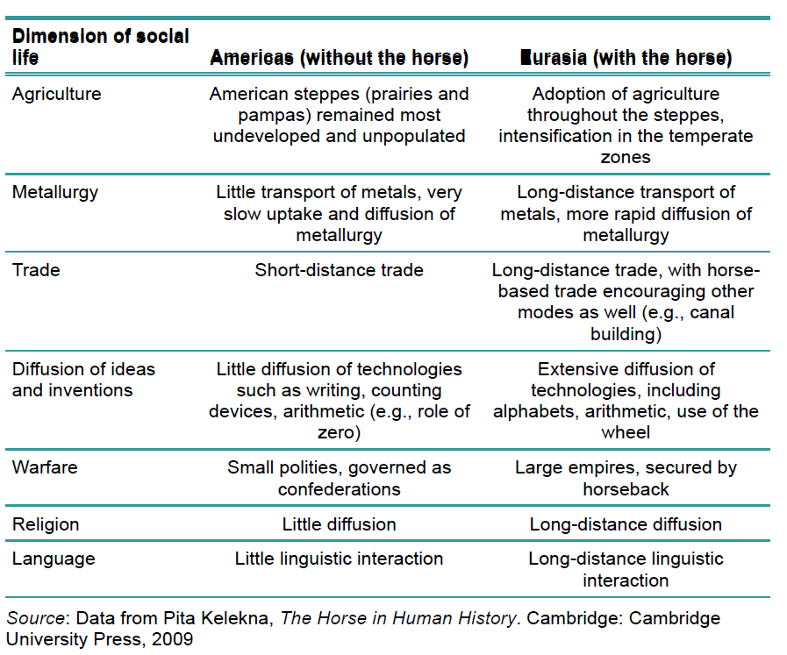
Comparing Old World and New World Developments
The extinction of the wild horse in the early Holocene meant that the Amerindians were bereft of horses until the arrival of the European conquerors. Nor did they have the benefit of the donkey, which originated in North Africa and did not arrive to the Americas until the Colombian exchange.

Slide 31
Some Lessons from the Equestrian Age
The period from 3000 to 1000 BCE was transformative for the major civilizations of Eurasia. Three profound technological breakthroughs were most decisive: the domestication of the horse, the development of writing systems, and the breakthroughs in metallurgy. These were accompanied by dramatic advances in public administration, religion, and philosophy, especially in the Fertile Crescent.
By the end of the Equestrian Age, around 1000 BCE, large land empires were beginning to emerge beyond their riverine home base. The first was the neo-Assyrian empire, which would briefly conquer Mesopotamia, the Levant, eastern Anatolia, and Egypt. Yet that empire merely set the stage for even larger empires that would arise across the lucky latitudes of Eurasia.

Slide 32
4 The Classical Age (1000 BCE–1500 CE) (pp. 69-94)
The period between 1000 BCE and 1500 CE gave rise to civilizations so dynamic that they set a standard of achievement hailed ever since as the Classical Age.
Many of the world’s major religions—Judaism, Christianity, Islam, Buddhism—were forged in this period. The great philosophies of life, as taught by Plato and Aristotle, Confucius, the Buddha, and other sages, our greatest wisdom traditions, are from this period.
The great empires of the age—Assyria, Persia, Greece, Rome, India, China, and later the Ottoman and Mongol empires—competed for glory, beliefs, wealth, and power with an unprecedented level of ambition...
We can call this an era of globalization by politics, since the imperial states consciously and deliberately aimed to create global civilizations.

Slide 33
4 The Classical Age (1000 BCE–1500 CE) (pp. 69-94)
The empires used the apparatus of state power to disseminate ideas, spread technologies, introduce new institutions, and build infrastructure on a continental scale, such as the Roman roads, amphitheaters, and aqueducts that still stand throughout Europe, North Africa, the eastern Mediterranean, and western Asia.
These were states that acted boldly, sometimes recklessly, and often violently, to spread ideas and to multiply their power and wealth.
A major distinction of this era is the development of writing by both the Phoenicians (in modern day Lebanon) and the Greeks. The other empires in Eurasia also adopted script writing at this time.

Slide 34
The Axial Age
The twentieth-century German historian and philosopher Karl Jaspers offered a crucial insight into this era with his concept of the Axial Age. Jaspers noted that during a span of roughly five hundred years, between 800 and 300 BCE, there was a simultaneous emergence of profound philosophical and religious insights in four major civilizations of Eurasia: the Greco-Roman world of the Mediterranean Sea, the Persian world of western Asia, the Aryan world of northern India, and the Han Chinese world of East Asia. In all four cases, there occurred remarkable and foundational breakthroughs in thinking about the meaning and purpose of life.

Slide 35
Thalassocracy and Tellurocracy
As the pace of economic and intellectual development hastened in the eastern Mediterranean and western Asia around 1000 BCE, two kinds of civilizations developed side by side. The first consisted of city-states with economies based on sea-based trading networks, of which the most remarkable were the Phoenicians and the ancient Greeks; the second were the city-states based on agriculture and mining that eventually became the land-based empires of the Classical Age. Ancient Greek offered two wonderful words for these distinct civilizations: thalassocracy (“thalatta” meaning sea and “cracy” for power) and tellurocracy (“tellus” for land).

Slide 36
Global Trade Within the Lucky Latitudes
The three great empires and the northern kingdoms of the Indian subcontinent engaged in a long-distance exchange of technologies, manufactured goods, and ideas. The steppe regions provided the highways along the so-called Silk Road that connected Rome in the west with the Han Empire in the east (figure 5.6). Silks from China flowed into Rome, while glassware from the Mediterranean glassworks flowed into China. The Silk Road carried official embassies, such as one from Roman emperor Marcus Aurelius (r.161–180 CE) to the Han emperor, as well as philosophers and teachers. The first mention of Buddhism in China, arriving from its home in northern India, occurred in 65 CE.

Slide 37
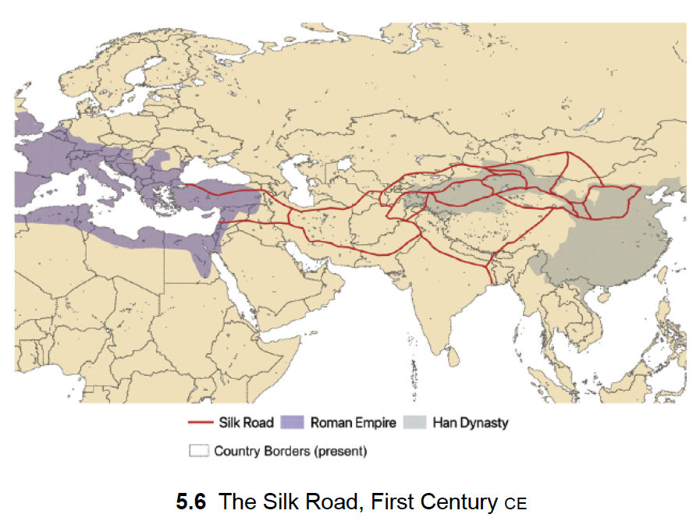
Global Trade Within the Lucky Latitudes

Slide 38
The Fall of Rome and the Rise of Islam
Despite Rome’s dominance of technology and population, the political stability of the Roman Empire waned over time. In 285 CE, the Roman emperor Diocletian divided the rule of the vast empire between the Eastern Roman Empire ruled from Byzantium, later Constantinople, and the Western Roman Empire ruled from Rome.
While the governance of the Roman Empire would go through further cycles of unity and east-west division, Diocletian’s decision was never permanently reversed. The Western Roman Empire succumbed to conquest by Germanic tribes from the north, with the final fall of Rome in 476 CE. Meanwhile the Eastern Roman Empire lived on as the Byzantine Empire and still governed most of the Mediterranean basin from Constantinople. The extent of the Byzantine Empire in 555 CE is shown in figure 5.7.

Slide 39
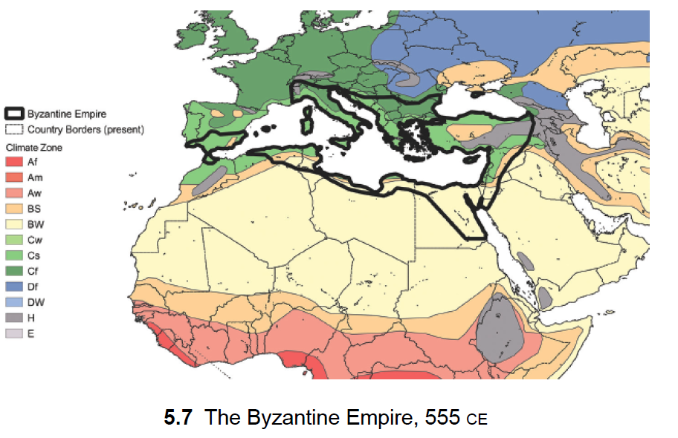
The Fall of Rome and the Rise of Islam

Slide 40
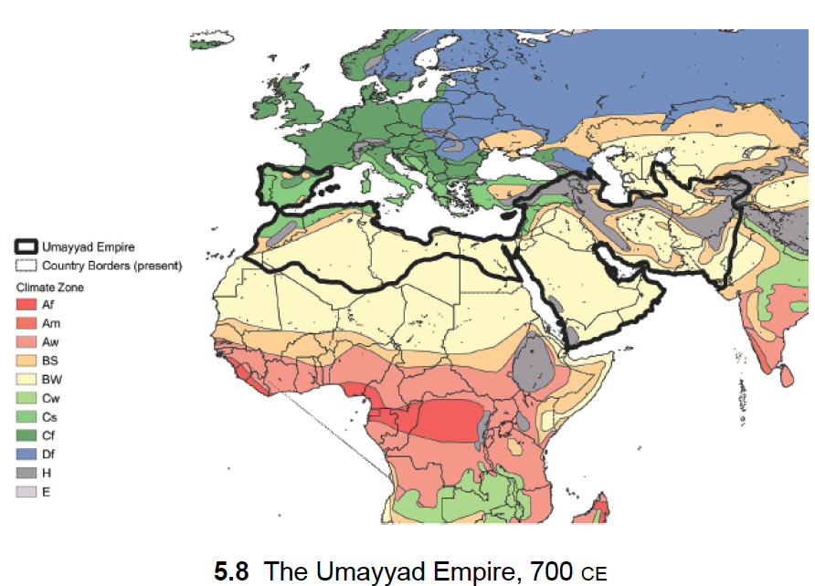
The Fall of Rome and the Rise of Islam

Slide 41
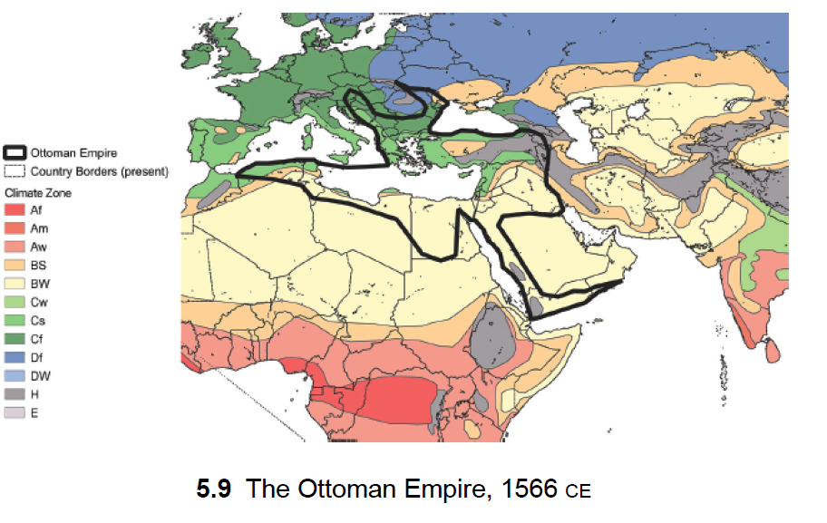
The Fall of Rome and the Rise of Islam

Slide 42
The Remarkable Song Dynasty of China
During the same years as the rise of the Seljuks and Ottomans, China was experiencing another golden age, the Song Dynasty, which is dated from 960 to 1279 (figure 5.10). On the eastern border of temperate Eurasia, a newly unified and peaceful China entered a period of stunning technological innovation, population growth, and economic prosperity. China’s remarkable successes in technologies (such as the compass and gunpowder) and in governance (such as the issuance of paper currency) would eventually travel west and empower Western Europe in its global ascent after 1400. Yet for several centuries, China was far in the lead in technological innovations and peaceful governance. At the base of the Song triumphs was the excellence of governance. The Song Dynasty has been termed “The Age of Confucian Rule.”

Slide 43
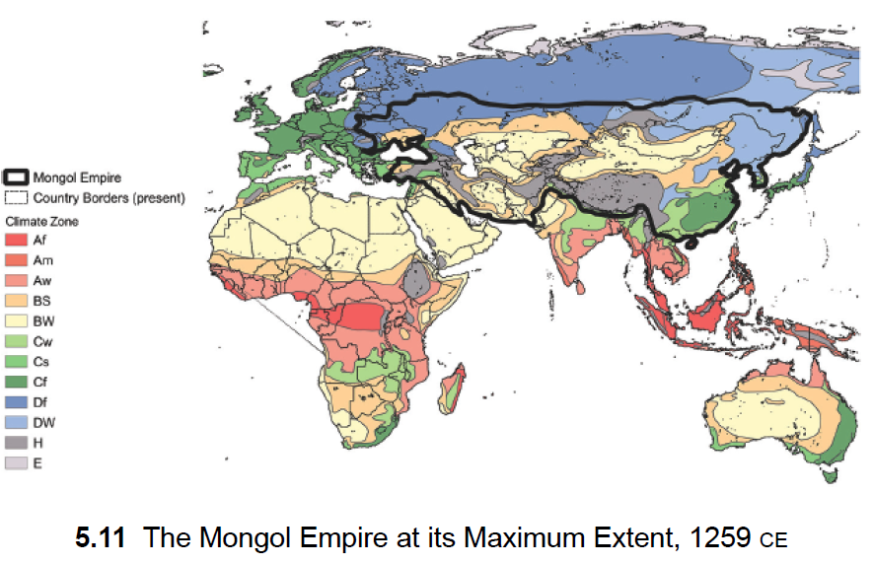
Mongol Empire

Slide 44
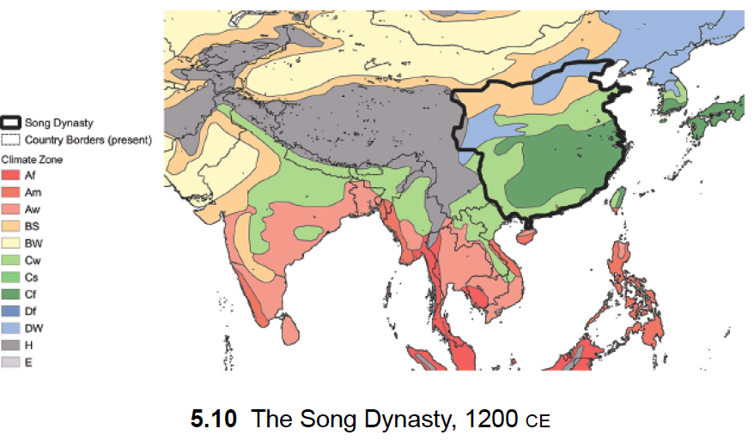
Song Dynasty

Slide 45
4 The Classical Age (1000 BCE–1500 CE) (pp. 69-94)
The Arab Islamic contributions/transmissions of Greek philosophy, medicine, mathematics, and astronomy in Arabic translations to Europe during the Renaissance.
The technological and scientific advancements of the Song Dynasty, China’s golden age, which was the “world’s first large-scale capitalist economy” (90).

Slide 46
4 The Classical Age (1000 BCE–1500 CE) (pp. 69-94)
Thus, the Classical age comes next, signifying an era of globalization by politics. Greco-Roman, Persian, Islamic, Mongolian and Chinese Empires disseminate ideas, spread technologies, introduce new institutions, and build infrastructures on a continental scale.

Slide 47
Some Lessons from the Classical Age
It is easy to be awed by the Classical Age, with its breathtaking scale, dramas, and achievements. Here was civilization-making on a grand scale. Four great civilizations—Greco-Roman, Persian, Islamic, and Chinese—vied for power, while also engaging in longdistance trade and a continuous interchange of ideas and technologies across Eurasia. Of course, these achievements did not include the entire world; I have left out the stories of Africa, the Americas, and Oceania during this era. Yet it is also starkly true that Eurasia was home to 85 percent of humanity from 1000 BCE to 1 CE and 77 percent in 1500 CE.7 And within Eurasia, the lucky latitudes were home to 67 percent of the Eurasian population in 1000 BCE and 57 percent in 1500 CE. As I’ve repeatedly emphasized, much of world economic history and technological advances were concentrated in the Eurasian lucky latitudes.

Slide 48
Some Lessons from the Classical Age
Two thousand years ago, the potential for multinational governance at a vast scale was already achieved. The European Union, one can say, seeks to govern Europe at the scale of the Pax Romana, but without the imperial wars and without the chauvinism of one people dominating the rest. The People’s Republic of China similarly aims for the internal peace of the Han Dynasty and the remarkable innovative spirit of the Song Dynasty. Today’s Islamic world is fragmented, yet the Golden Age of Islam under the Abbasid Caliphate of Baghdad reminds us of the era when Islamic scholars led the world in knowledge and sought ancient wisdom from all sources in order to create an integrated knowledge and science. That noble effort saved much of the Classical heritage for later generations, including our own.

Slide 49
5 The Ocean Age (1500–1800) (pp. 95-128)
As of 1500, we arrive at a pivotal moment in human history, when the Old World and the New World were suddenly reunited through oceangoing vessels, and when Europeans first sailed to Asia by circling the Cape of Good Hope at the Southern tip of Africa.
For the first time in more than ten thousand years, ever since the land bridge Beringia between Asia and Europe was submerged at the beginning of the Holocene, there resumed an active interchange between the Old World and the Americas.
Two voyages of the 1490s—those of Christopher Columbus from the Atlantic coast of Spain to the Caribbean in 1492 and of Vasco de Gama from Lisbon to Calicut, India, in 1498 and back in 1499—decisively changed the direction of world history.
Why did Western Europe rather than East Asia come to dominate the seas, and thereby the world?

Slide 50
The Great Chinese Reversal
In the early 15th century, China under the Ming Dynasty, led by the Yongle Emperor, embarked on ambitious maritime expeditions known as the voyages of Zheng He. These voyages were intended to showcase China's power and establish Chinese dominance in the region. However, after the Yongle Emperor's death, the Ming Dynasty shifted its focus away from maritime activities.
The term "The Great Chinese Reversal" is often used to describe this shift in policy, where China turned inward and focused more on domestic issues, leading to the decline of its maritime influence and a withdrawal from active exploration and trade with other nations. This period marked a significant change in China's approach to foreign relations and had long-lasting effects on its role in global affairs.

Slide 51
The North Atlantic Quest for Ocean Navigation
The North Atlantic Quest for Ocean Navigation refers to the historical period when European sailors and explorers sought to find a direct sea route from Europe to Asia by sailing westward across the Atlantic Ocean. The main reason that Europeans were searching for a sea route to Asia was the knock-on effect of the fall of the Eastern Roman Empire. In 1453, the Ottoman sultan Mehmed II defeated the Byzantine emperor Constantine XI Palaiologos and occupied Constantinople. With the Ottoman Empire reigning in the newly named Istanbul, the ancient silk routes and sea routes to Asia were at risk.
The most famous explorer associated with this quest is Christopher Columbus, who famously set sail in 1492 under the patronage of Spain in search of a western route to Asia. Instead, Columbus reached the Americas, leading to the European exploration and colonization of the New World.
Subsequent explorers and navigators, including John Cabot, Vasco da Gama, and Ferdinand Magellan, continued the quest for a sea route to Asia, eventually leading to the establishment of new trade routes and the globalization of trade and culture. This period of exploration and discovery had profound effects on world history, shaping the modern world as we know it.

Slide 52
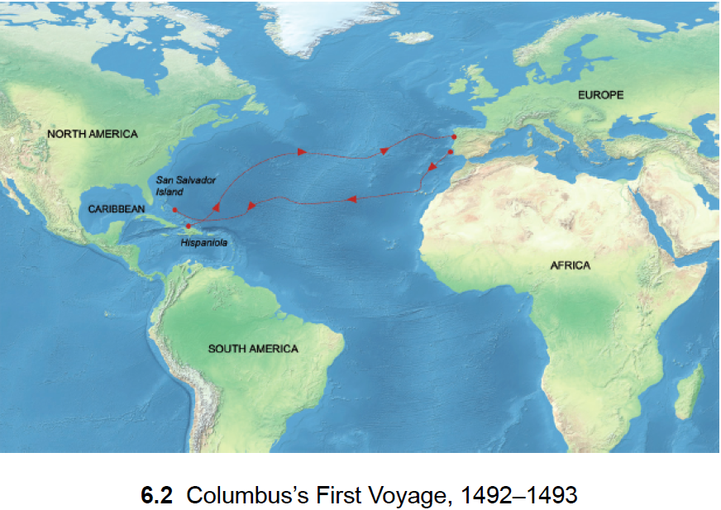
Columbus’s First Voyage

Slide 53
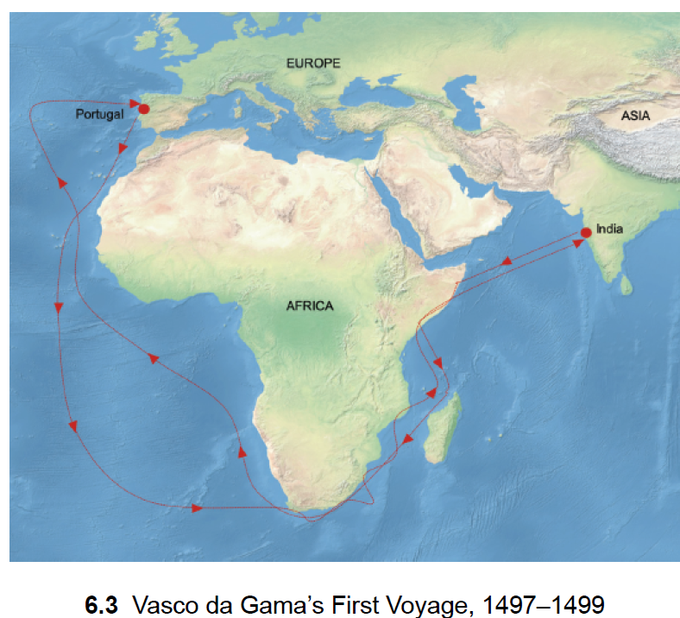
Vasco da Gama’s First Voyage

Slide 54
The Columbian Exchange
The Columbian Exchange refers to the widespread transfer of plants, animals, culture, human populations, technology, and ideas between the Americas, West Africa, and the Old World (Europe) that occurred following the voyage of Christopher Columbus in 1492.
For example, crops like potatoes, corn, and tomatoes were introduced to Europe, while crops like wheat, rice, and sugarcane were introduced to the Americas.
Additionally, the exchange of diseases had devastating effects on indigenous populations in the Americas, as they had no immunity to diseases like smallpox, measles, and influenza brought by Europeans. This resulted in a significant decline in the indigenous population.
The Columbian Exchange also facilitated the exchange of ideas, technology, and culture between the Old World and the New World. It led to the globalization of trade, the spread of Christianity, and the exchange of artistic and intellectual ideas.

Slide 55
Why the Ming Dynasty shifted its focus away from maritime activities?
Financial Strain: The voyages of Zheng He were expensive, and they put a significant strain on the Ming Dynasty's finances.
Military Threats: The Ming Dynasty faced military threats from the north, particularly from the Mongols.
Political Change: The Yongle Emperor, who had sponsored the voyages of Zheng He, died in 1424. His successors did not share the same enthusiasm for maritime exploration and trade. They were more focused on consolidating power within China and maintaining stability.
Isolationist Tendencies: There was a growing sense of isolationism within the Ming Dynasty. The emperors believed that China was self-sufficient and did not need to engage extensively with other nations.
Confucian Influence: Confucian scholars in the Ming court argued against the voyages, viewing them as a wasteful extravagance that did not align with Confucian values of frugality and humility.

Slide 56
The Gunpowder Age and the High Seas
In the Indian Ocean, European nations faced established societies with strong military capabilities and shared pathogens. Despite this, they gained dominance through military technologies like gunpowder and fortresses, originally from China.
Europeans innovated cannons, placed them on ships, and established colonies and trading posts, gaining trade advantages while China lost authority and trading income due to its tributary system collapse and Europe's rising military strength.

Slide 57
The New European Age of Inquiry
The fall of Constantinople and the discovery of sea routes to the Americas and Asia reshaped the European worldview. Greek scholars fleeing Constantinople brought ancient knowledge to Europe, sparking the Renaissance.
The invention of printing accelerated the spread of ideas. This era saw groundbreaking works challenging traditional beliefs, like Erasmus's "In Praise of Folly," Machiavelli's "The Prince," and Copernicus's heliocentric theory.
"In Praise of Folly (critiques societal norms and the Church), "The Prince," (rulers should prioritize maintaining power over moral considerations), and Copernicus's heliocentric theory (the Earth and other planets revolve around the Sun).
These events led to the Reformation and a scientific revolution, with figures like Galileo and Newton. Institutions like the Royal Society and the French Academy of Sciences promoted scientific inquiry. The Jesuit order played a key role in disseminating European knowledge globally, establishing schools and missions worldwide.

Slide 58
The Birth of Global Capitalism
Europe’s new global-scale trade with the Americas and with Asia also marked the birth of global capitalism, a new system of global scale economic organization. The new economic system was marked by four distinctive features:
(1) Imperial power extended across oceans and ecological zones. The temperate-zone nations of Western Europe colonized tropical-zone regions in the Americas and Asia to produce tropical products such as tobacco, sugarcane, cotton, rubber, or minerals.
(2) Production systems were globalized, with plantations and mines established in the colonized countries exporting primary commodities to the home country for industrial processing, notably in the case of cotton.
(3) Profit-oriented, privately owned corporations were chartered by European governments to carry out these global activities. The most important of these new chartered companies were the British East India Company, chartered in 1600, and the Dutch East India Company, chartered in 1602.
(4) These private companies maintained their own military operations and foreign policies under the protection of their founding charters and their states’ navies.

Slide 59
The Birth of Global Capitalism
In the Americas, European powers aimed to exploit natural resources like gold, silver, and crops for the European market. They introduced crops from Africa and Asia to cultivate, such as sugar, coffee, and rice, alongside native crops like cacao, cotton, rubber, and tobacco.
In Asia, the goal was to control trade routes and goods like spices, cotton fabrics, silks, and porcelains, which were previously controlled by Arab, Turkish, and Venetian intermediaries. European powers sought to establish direct trade and later to control production and suppress the export of Asian goods to Europe to protect European industries.
Private companies like the British East India Company and the Dutch East India Company were given monopolies by their governments to trade in Asia, aiming to dominate the trade that Portugal and Spain had previously controlled. These companies became early forms of multinational corporations, eventually playing a significant role in global trade and sometimes even political control, as seen with the British East India Company's influence over India.

Slide 60
The Intertwining of State and Capital
Not only have capitalist enterprises often been extraordinarily ruthless in their pursuit of profit; they have often, even typically, had the power of the state at their disposal to magnify their profits and shift losses to others, sometimes to fellow citizens but more often to the weak and vulnerable of other societies.
Consider Britain’s entry into global markets in its competition with Spain and Portugal. Queen Elizabeth was a personal investor in 1577 in Francis Drake’s plan to circumnavigate the globe on his vessel the Golden Hind. Yet in addition to exploration, the real plan was piracy: to loot the Spanish fleet bringing bullion and other treasures back from South America. In 1578, Drake captured a Spanish galleon with a phenomenal haul of gold, silver, jewels, porcelain, and other treasure. On Drake’s return, the pirated gains were shared with the queen, who used them to pay off the national debt. Drake became a national hero, and went on to serve as vice admiral in the defeat of the Spanish armada in 1588.

Slide 61
The Intertwining of State and Capital
The launch of the East India Company in 1600 marked a significant advancement toward modern capitalism. It was a joint-stock company formed for multinational trade, supported by state power. Queen Elizabeth granted it a monopoly over trade in certain regions, and the company engaged in bribery and operated like a state within a state in India, even maintaining a private army.

Slide 62
Indigenous Populations and African Slaves in the New World
The history of the New World involves three main groups: indigenous peoples, European conquerors and settlers, and African slaves. The conquest and stratification of these groups have led to sky-high inequality and conflict in the Americas. European conquerors sought wealth and glory, but struggled with the challenge of labor for wealth production. They found gold and silver mines, but even these required laborers for dangerous work. Plantations also required harsh labor in tropical conditions, leading to early death for many workers. Enticing European settlers to these lands was difficult due to the grim realities of life there.
Indigenous populations in the Americas survived in mountainous and sparsely settled regions but suffered greatly in areas where Europeans conducted intensive mining and plantation operations. Spanish conquerors initially granted land and authority, known as encomiendas, to elites, allowing them to enslave natives. This sparked a debate, with Bartolome de las Casas arguing against enslavement, leading to the issuance of the New Laws in 1542, which outlawed the enslavement of indigenous Americans, a rare case of moral reasoning prevailing over power and greed.

Slide 63
Triangular Trade
With the slave plantations in the Americas arose the infamous three-way trade pattern commonly known as the “triangular trade.” The slave colonies of the Americas imported slaves and exported slave-made products—sugar, cotton, and tobacco—to Europe.
Europe imported the commodities and exported manufactured goods, including textiles, weapons, and metals, to Africa.
And African chieftains exported slaves to European slave traders in return for Europe’s manufactured goods.

Slide 64
Slave Trade
In total, an estimated 14 million Africans were carried as slaves during this period. This was truly a grim and horrific stage of global capitalism.
The cruelty that accompanied the development of the modern world economy must not be forgotten, because that cruelty shows up in other ways today; human trafficking is one of the greatest examples, which also continues in the form of bonded labor and child labor as part of global supply chains. Humanity is not done with the horrific abuse of others in pursuit of greed and profit.

Slide 65
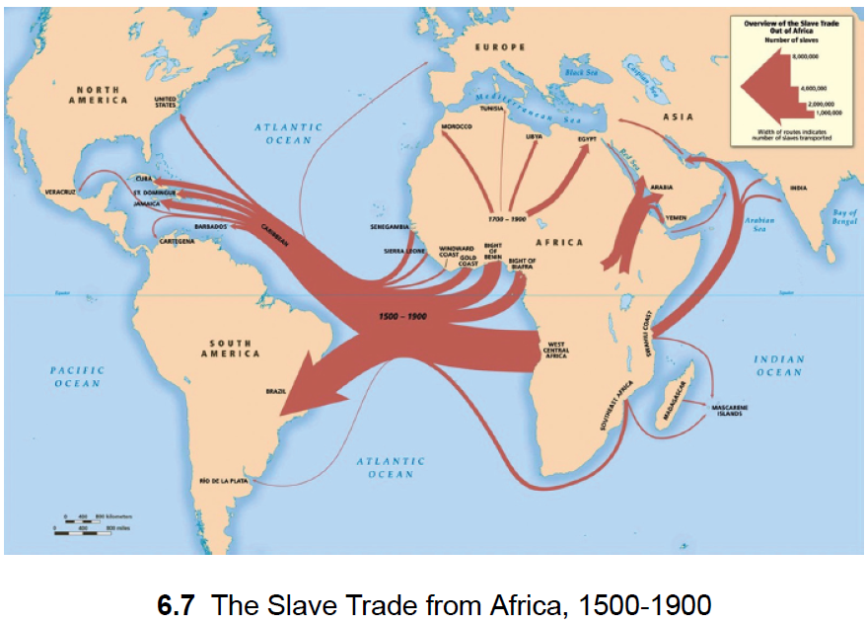
The Slave Trade from Africa, 1500-1900

Slide 66
Feeding Europe’s Factories: Cotton
The British and Dutch East India companies may rightly be considered the first corporations of modern capitalism. As profitdriven and greed-based joint-stock companies, they set the tone and behavior for what was to come.
As described by historian Sven Beckert in his book Empire of Cotton: A Global History, much of their early business in the 1600s was trade in cotton fabrics, purchased in India for sale in Africa to slave traders and in Europe to the growing urban population. Then, in the eighteenth century, as Britain protected its domestic textile manufacturers against Indian imports, British manufacturers increasingly demanded a supply of raw cotton.
The demand multiplied with the mechanization of spinning and weaving, and then with the introduction of steam power into the textile mills.

Slide 67
Global Empire and Global War
Europe’s global empires, spanning oceans and continents for the first time, unleashed another new phenomenon, global war, also spanning oceans and continents. From the late seventeenth century on, major conflicts among the European powers involved battles on several continents. The implications were dire. More and more of the world would be swept into Europe’s wars, so that eventually the two world wars of the twentieth century each claimed tens of millions of lives across the globe.
The Nine Years’ War of 1688–97 is often considered the first global war, as it was fought simultaneously in the Americas, Europe, and Asia. The main European combatants were France, led by Louis XIV, against a coalition of Britain, Holland, and the Holy Roman Empire. The war began in Europe, where France sought to expand its influence into neighboring countries. In Britain, the conflict led to the Glorious Revolution of 1688, during which William of Orange invaded and took the throne from King James II.

Slide 68
Adam Smith’s Summation of the Age of Global Empire
Adam Smith, in "The Wealth of Nations" published in 1776, viewed globalization with a global perspective, emphasizing the importance of impartiality in moral reasoning.
Smith considered the discovery of America and the sea route to the East Indies as the two most significant events in human history, believing that their consequences would continue to unfold over time.
He noted that while these events had the potential for mutual benefit through trade and exchange, they had thus far benefited Western Europe at the expense of the East and West Indies, which suffered from European exploitation.
Smith envisioned a future where the balance of power would shift, leading to mutual respect among nations. He believed that this would be achieved through the spread of knowledge and improvements facilitated by global commerce.
Smith's insights on the potential for a more balanced and fair world, where all nations respect each other's rights, remain relevant today as nations like China and former colonies gain strength through participation in the global economy.

Slide 69
Some Lessons from the Ocean Age
The Ocean Age marked the emergence of global capitalism, with privately chartered for-profit companies engaging in global-scale production and trading networks.
Private businesses, driven by greed, employed private armies, enslaved millions, and used bribery to gain privileged political status both at home and abroad.
The era was characterized by conquest and unchecked competition among Europe's powers, leading to rapacious behavior in the newly accessible regions across the oceans.
Adam Smith's "The Wealth of Nations" advocated for global trade as a driver of specialization and rising productivity, a concept that proved highly successful and led to self-feeding growth.
This period saw the rise of a new kind of political power, the hegemonic power, exemplified by Great Britain's dominance surpassing even that of the Roman Empire.
However, the gains for major powers often came at the expense of misery for those under their control, particularly evident in the Industrial Age.

Slide 70
5 The Ocean Age (1500–1800) (pp. 95-128)
From the 16th century onwards, the following Ages of Globalization are dominated by the West, especially Great Britain and later on the United States. During the Ocean and Industrial Ages, the subjects of chapters four and five, Britain came to dominate the Seas. Instrumental were Britain’s advancements in science, technology, and knowhow; energy production of coal (and later petroleum and natural gas); and oceanography and printing. Britain and other European powers colonized the New World and many parts of Asia, Africa, and Australia.
If the Ocean Age (chapter six) announced the birth of global capitalism, the Industrial Age (chapter seven) grounded it with Britain becoming the superpower hegemon (167). Sachs notes the reasons behind Britain’s imperial supremacy, as well as the accompanying greed, profiteering, brutality, and cruelty that were deployed against the “other.” To the decimation of indigenous populations by pathogens and massacres, the founding and sustenance of Western Empires added “war, plunder, conquest, and subjugation of indigenous communities and destruction of their cultures” (103).

Slide 71
5 The Ocean Age (1500–1800) (pp. 95-128)
The Ocean Age brings the birth of global capitalism, where imperial power extends across oceans and ecological zones. During this age, western production systems were globalized with plantations and mines in the Americas and elsewhere, while profit oriented privately owned corporations maintained their military operations and foreign policies. Conquest was justified as a God-given given right, whereby civilization was brought to the heathens. Financial success became a sign of God's favor and providence.

Slide 72
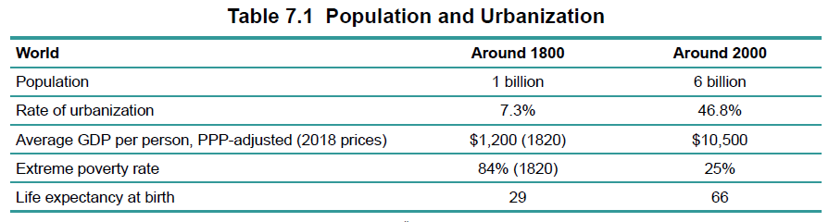
6 The Industrial Age (1800–2000) (pp. 129-168)
A remarkable change during this age of Industrialization.

Slide 73
1776
The year 1776 marks a significant starting point for the investigation of industrialization due to four key events.
First, Birth of the United States: The Declaration of Independence in 1776 led to the creation of the United States, which later became a global power.
Second, Publication of Adam Smith’s Wealth of Nations: This work introduced ideas of a modern economy based on global reach and division of labor.
Third, Publication of Edward Gibbon’s Decline and Fall of the Roman Empire: Gibbon's work exemplifies the enlightenment era and reminds us of the decline of world-dominant powers, similar to what happened to the British Empire and is happening to the United States.
Fourth, Commercialization of James Watt's Steam Engine: James Watt successfully commercialized his steam engine in 1776, a pivotal invention that gave birth to the Industrial Age and enabled many other technological breakthroughs of the past two centuries. These events together capture the essence of the Industrial Age and its impact on the modern economy.

Slide 74
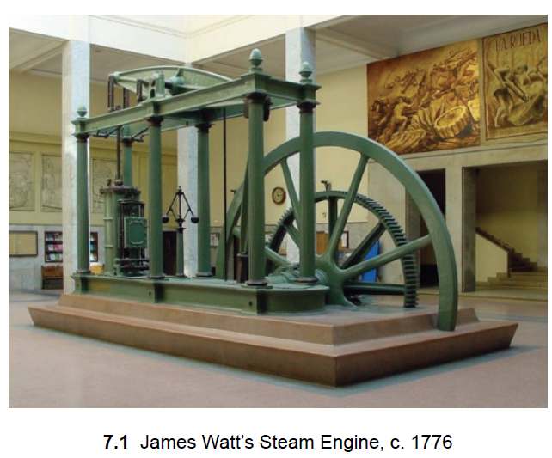
Steam Engine - 1699
In 1699, Thomas Savery invented the first modern steam engine, which used steam from burning coal to pump water. The goal was to increase the productivity of coal mines by removing water from them.
Thomas Newcomen advanced Savery's idea by introducing the concept of using steam power to move a piston. His 1712 steam engine used steam to move a piston, which then pumped water from mines.

Slide 75
Steam Engine - 1760
Newcomen's Inefficient Engine: Newcomen's steam engine, used to pump water out of coal mines, was inefficient and required a lot of energy input.
James Watt's Innovations: In the 1760s, James Watt, working in a workshop at the University of Glasgow, made two key innovations to improve Newcomen's engine.
Introduction of Rotary Motion: Watt introduced rotary motion into the steam engine, replacing the alternating beam used by Newcomen.
Separate Condenser: Watt's most revolutionary change was adding a separate condenser to the steam engine. This made the engine significantly more efficient by reducing heat waste.
Transformation of the Steam Engine: Watt's improvements turned the steam engine from a high-cost device for pumping water into a low-cost device with a wide range of potential uses.

Slide 76
From the Organic Economy to the Energy-Rich Economy
E. A. Wrigley describes a major change in economies from relying on organic materials like plants and animals for energy to using coal and other fossil fuels. Before this shift, most production relied on human and animal labor, with only a small amount of energy coming from wind and water. The introduction of coal and later petroleum and natural gas freed economies from the limitations of organic-based energy, allowing for significant economic growth.

Slide 77
Why Did Industrialization Start in Britain?
Britain's industrialization was the result of a unique combination of factors that came together at the right time and place.
Intellectual Milieu: Britain had a culture that respected science and empiricism, leading to advancements in knowledge and technology. Figures like Roger Bacon and Francis Bacon contributed to this culture.
University Support: Universities in Britain, such as the University of Cambridge and Glasgow University, supported scientific inquiry and technological innovation.
Market Institutions: Britain had well-developed market institutions, including strong property rights and patent laws, which encouraged entrepreneurs like Watt to develop new technologies.
Access to Capital: Watt was able to attract private capital for his inventions, which allowed him to develop his technology as a business venture.
Coal Industry: Britain had easy access to coal, which was crucial for powering steam engines and driving industrial growth.
Global Trade: Britain's participation in a global trading system, facilitated by multinational companies like the East India Company, provided a large market for industrial goods.

Slide 78
Endogenous Growth and Kondratiev Waves
Suppose that there are ten distinct technologies. There are then forty-five two-way combinations of the ten technologies (1/2 × 10 × 9). Suppose that 20 percent of those pairwise combinations yield a useful new technology. We would have nine additional technologies. The nine new technologies could then hybridize (combine) with each other or with the original technologies, to produce yet more innovations. Weizmann called this ongoing process “recombinant growth.”
Innovations drive economic growth by creating opportunities for profits. Each technological breakthrough, like Watt's steam engine, can double the size of the economy, leading to more incentives for further inventions. This cycle of innovation leading to a larger market size, which then fosters more innovation, is known as "endogenous growth." Paul Romer's work in the 1980s provided a mathematical framework for understanding this self-sustaining process.

Slide 79
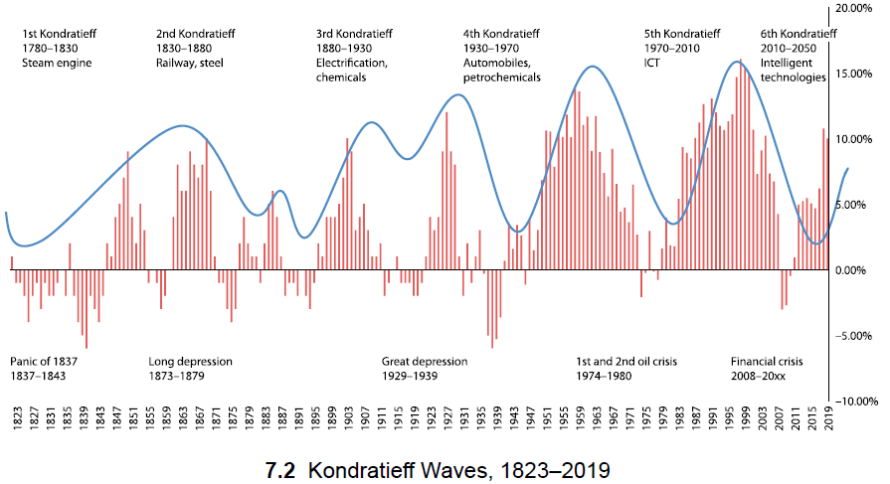
Endogenous Growth and Kondratiev Waves
Kondratiev Waves, also known as Kondratieff Waves or long waves, are a theory in economics that suggests there are long-term, wave-like cycles in economic activity that last between 40 to 60 years. These cycles consist of alternating periods of high economic growth and prosperity (upwaves) and periods of stagnation or recession (downwaves). [Russian economist Nikolai Kondratiev proposed this theory in 1920s].

Slide 80
The Diffusion of Industrialization in Europe
Industrialization started in Britain and then gradually over time moved to the rest of Europe, with those regions farthest away generally industrializing at a later date. It’s a bit like dropping a stone in water. The ripples go outward in concentric circles, so the impact is felt earliest near where the stone hits the water and only later at greater distances.
What is the reason for this gradual diffusion? Remember that Britain’s industrialization had several foundations, including a market for industrial products, access to coal, access to transport, industrial skills, and technological know-how. These were the prerequisites as well for the later arrivals to industrialization.

Slide 81
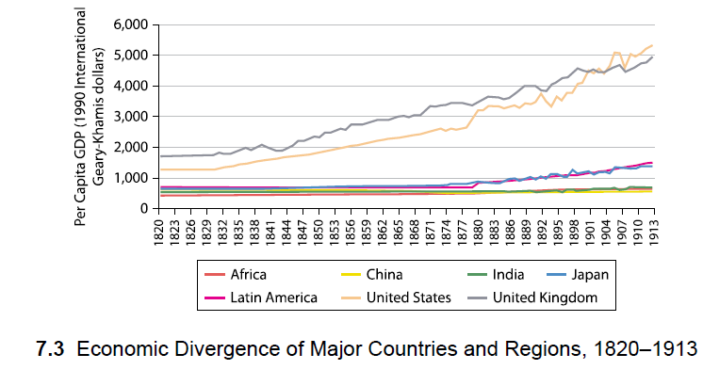
The Great Global Divergence
The age of industrial globalization dramatically increased the gap between the North Atlantic—Western Europe and the United States—and the rest of the world in terms of incomes, industrial production, and military power.

Slide 82
The Asian Drama: China, India, and Japan
Despite China's vast population and historical significance, it faced humiliation and encroachment. India suffered even more, falling entirely under British colonial rule. Japan, however, managed to industrialize and maintain its sovereignty, becoming a military power in Asia. These different outcomes highlight the complexity of economic and political history in the region.
China's nineteenth-century history began with rejections of British trade missions in 1793 and 1816. However, Britain eventually forced China to open its ports to trade, including the importation of opium, through the Opium Wars starting in 1839. The Nanjing Treaty of 1842 and the Second Opium War of 1856-60 further expanded British influence in China, leading to the cession of Hong Kong and other concessions.
The incursion of the European imperialists put China into an economic tailspin from which it would not recover for more than a century.

Slide 83
The Asian Drama: China, India, and Japan
The Qing Dynasty collapsed in 1912, leading to the declaration of the Republic of China by Sun Yat-Sen.
Internal disorder and fragmentation ensued, with warlords vying for power.
In 1927, the Nationalist government attacked the Chinese Communist Party, sparking a civil war lasting until 1949.
Japan invaded China in 1931, occupying parts until their defeat in 1945.
In 1949, Communist forces under Mao Zedong defeated the Nationalists, establishing the People's Republic of China.
Mao initiated a Soviet-style economy in the 1950s but launched the disastrous Great Leap Forward in the late 1950s, resulting in millions of deaths.
The Cultural Revolution (1966-1976) further plunged China into chaos and upheaval.
Market-based economic reforms began in 1978, 130 years after the First Opium War, transforming China from a rural, impoverished economy.

Slide 84
The Asian Drama: China, India, and Japan
India's decline from its position as a major manufacturing and economic power began in the seventeenth century under Mughal rule. Challenges to Mughal authority led to the rise of regional powers, including the Marathas in the Deccan and the British East India Company in Bengal. The Battle of Plassey in 1757 marked the company's effective control over Bengal, and subsequent wars allowed it to extend its rule over India. British economic policies, including trade protectionism, devastated India's textile industry and contributed to widespread poverty and famines. British governance, marked by administrative ruthlessness, further weakened the economy and society. India's political independence in 1947 paved the way for its industrialization and development, which had been hindered during British colonial rule.

Slide 85
The Asian Drama: China, India, and Japan
Industrialization in the 19th century was unique to Japan in Asia, as it avoided European subjugation and undertook internal reforms. Japan's early modern history began in 1603 under Tokugawa Ieyasu's rule, with the Tokugawa Shogunate lasting until 1868. During this period, Japan limited international contacts and trade, leading to internal peace and cultural development. Commodore Perry's arrival in 1853 marked a turning point, with Japan responding quickly to Western threats and embarking on industrialization.
The Meiji Restoration in 1868 modernized Japan, ending feudalism, establishing a centralized government, and reforming various aspects of society. Japan's transformation was largely peaceful, leading to rapid industrial growth and military strength. By 1913, Japan's per capita income was significantly higher than China's, showcasing its successful modernization efforts.

Slide 86
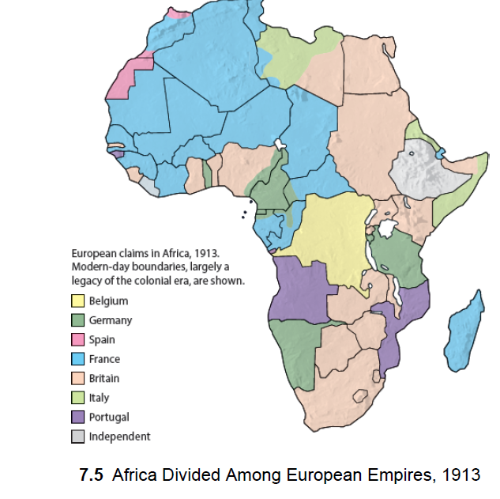
Europe Swallows Africa

Slide 87
Anglo-American Hegemony
Sachs describes the rise and decline of Anglo-American hegemony during the 19th and 20th centuries. He highlights Britain's dominance as an imperial power, with Queen Victoria reigning over a vast empire that included territories in Africa, Asia, and the Americas.
Sachs also discusses the economic growth of the United States, which eventually surpassed Britain to become the world's largest economy. Despite their economic and military power, both the British Empire and the United States faced challenges, leading to the decline of British imperialism and the emergence of the United States as a global superpower.
Sachs concludes this section by comparing the fall of European empires to historical examples of other empires being defeated, suggesting that Europe's dominance was also destined to end.

Slide 88
The Thirty-Year European Bloodletting
The period from 1914 to 1945 was a disastrous time in Europe, akin to Europe's second Thirty Years' War, involving major industrial powers and resulting in immense destruction and loss of life.
World War I, which started in 1914, was supposed to be the "war to end all wars," but instead set the stage for further conflict due to the harsh terms of the Treaty of Versailles, leading to economic instability and the rise of Hitler's regime in Germany.
World War I was a war without a clear purpose, triggered by the assassination of Archduke Franz Ferdinand of Austria, and escalated due to complex alliances and rivalries among European powers.
The war saw the first fully industrialized conflict, with new technologies like tanks, machine guns, and aerial bombings causing unprecedented destruction and casualties.
The aftermath of World War I led to the collapse of empires (Habsburg, Prussian, Ottoman, Romanov), economic depression in the 1930s, and profound political and social dislocation across Europe, Russia, and the Middle East.

Slide 89
The Thirty-Year European Bloodletting
The punitive measures imposed on Germany after World War I, including heavy reparations payments, contributed to economic disarray and set the stage for Hitler's rise to power and the outbreak of World War II.
World War II, which started in 1939, further devastated the world, including the Holocaust and widespread destruction, but also led to the emergence of the United States as the dominant global economic power by the war's end.
The industrial might of the United States played a crucial role in the defeat of Nazi Germany and Japan, leading to a post-war world where the United States accounted for a significant portion of global output.
The wars of the early 20th century highlighted the destructive potential of industrialized warfare and the importance of international cooperation and diplomacy in preventing future conflicts.

Slide 90
The American Century
The concept of the American Century, coined by Henry Luce in 1941, reflects America's emergence as the dominant global economic, technological, and geopolitical power after World War II.
America's economic rise from the early 19th century to the mid-20th century was marked by unprecedented growth, industrialization, and technological innovation, making it a continental-scale industrial power.
The United States played a key role in establishing post-World War II institutions like the United Nations, the International Monetary Fund, and the World Bank to promote peace, stability, and economic development.
The Cold War between the United States and the Soviet Union shaped much of the postwar world, leading to a nuclear arms race and geopolitical competition that nearly resulted in global nuclear annihilation.
U.S. foreign policy during the American Century included both efforts to build law-based multilateral institutions and interventions aimed at promoting U.S. interests, sometimes through military force or regime change operations.
The United States established a vast network of military bases around the world, unparalleled in scale, to project its military power and protect its interests.
The American Century has been characterized by both prosperity and challenges, shaping the modern global order and the role of the United States in it.

Slide 91
Decolonization and the Onset of Global Convergence
World War II marked the decline of European empires, leading to a rapid unraveling of European colonization after 1945, as seen in the peaceful withdrawal from India and wars of liberation in Indonesia, Algeria, Vietnam, and elsewhere.
Decolonization enabled newly independent countries to pursue industrialization, invest in education and healthcare, and promote economic development, leading to a significant reduction in illiteracy and improvement in life expectancy.
The period after decolonization saw a shift from a long era of divergence to an era of convergence, with developing countries narrowing the income and technology gaps with early industrializers, particularly in East Asia.
The share of world income produced in Asia, Africa, and Latin America began to increase after 1950, marking a shift in global economic dynamics.

Slide 92
Decolonization and the Onset of Global Convergence
Since 1950, the world has experienced technological and economic convergence, with rising life expectancy, increased schooling, reduced extreme poverty, and a shift to higher skilled and less arduous work in the developing world.
The digital revolution, including technologies like artificial intelligence and robotics, is expected to further spur economic growth and convergence in developing countries.
The United States had a complex attitude toward decolonization and convergence, initially championing decolonization but later adopting a more self-interested stance, particularly evident in the "America First" policy under the presidency of Donald Trump.
Despite progress, around 700 million people are still in extreme poverty, highlighting the ongoing challenges of development.

Slide 93
Some Lessons from the Industrial Age
The Industrial Age brought rapid technological progress and material living standards, but economic gains were initially concentrated in Western Europe, the United States, and a few industrializing countries, leaving much of the world in poverty and political subservience.
Britain, the first mover of the industrial era, became the world's first superpower but rapidly lost power due to two world wars and the Great Depression, leaving behind legacies such as parliamentary democracy, global commerce institutions, and the use of English as a global lingua franca.
The United States claimed global hegemony after World War II but now faces challenges as power spreads more widely, especially with the end of European imperial rule in Africa and Asia leading to significant growth and reductions in extreme poverty in former colonies, particularly remarkable in China.
The current era is characterized by digital technologies reshaping global economics and geopolitics, with every sector of the economy affected. Global challenges include continuing economic convergence, addressing rising inequalities within nations, shifting geopolitics, and environmental threats.

Slide 94
6 The Industrial Age (1800–2000) (pp. 129-168)
We have arrived at the sixth age of globalization, the Industrial Age, the one that created the modern world. For convenience I date this from 1800 to 2000, lasting two centuries.
I could perhaps have put the starting date a bit earlier, say 1750, when industrialization began to gather force in Britain, or I might have put it at 1820, after the Napoleonic Wars, when the new peace in Europe would enable a continental-scale transformation more rapid than any other in history. But no matter the details, we can be certain of the overriding point: the sixth age is a...

Slide 95
6 The Industrial Age (1800–2000) (pp. 129-168)
A brief history of digitization from the 1930s onward introduces the “ubiquitous connectivity” (169) of the Digital Age of the 21st century, emphasizing also the role of Japan and China in the process. Sachs notes two historical facts: 1) Japan’s ability to thwart all attempts at colonization by the West and its choice to follow a free market-based economy; 2) after 1978, Chinese Communist leadership shift to implement the same strategy of export-led, labor-intensive manufacturing. He adds that the four “Asian Tigers”—South Korea, Taiwan, Hong Kong, and Singapore— embarked on the successful catch-up strategy (180). Currently, the world economy is centered around three regions: the United States, the European Union, and Northeast Asia—China, Japan, and South Korea.

Slide 96
6 The Industrial Age (1800–2000) (pp. 129-168)
Industrialized nations, including Western Europe and the United States, achieve significant increases in output per person, reductions in extreme poverty, rapid urbanization, and structural shifts away from strenuous physical labor, with more opportunities for education and leisure.

Slide 97
7 The Digital Age (TWENTY-FIRST CENTURY) (pp. 169-194)
It is estimated that in 2020 the world will create and transmit roughly 44 zettabytes of data per day. In numbers, that is 44,000,000,000,000,000,000,000 bytes, each byte carrying the information of one letter or number. Yet soon enough, these staggering numbers will be superseded by even more remarkable numbers. The ubiquity and scale of data processing and transmission are utterly mind-boggling. Here are some other estimates as of 2019:
1.6 billion Facebook log-ons each day
3.5 billion Google searches each day
5 billion YouTube videos watched each day
4.4 billion Internet users (as of June 30, 2019)

Slide 98
7 The Digital Age (TWENTY-FIRST CENTURY) (pp. 169-194)
The seventh age of globalization, the Digital Age, begins in the 21st Century and encompasses the present. Through advances in information and communication technology, it brings ubiquitous connectivity to the world creating new patterns of global economic activity, jobs, lifestyles, and geopolitics.
However, this age also brings increasing environmental degradation, social inequality, and geopolitical conflict. Professor Sachs’ proposes a number of remedies for these global threats, including sustainable development and a more inclusive, participatory approach to political and economic life.

Slide 99
Guiding Globalization in the Twenty-First Century (pp. 195-214)
Each age of globalization has given rise to new tensions and wars.
In the Paleolithic Age, Homo sapiens drove to extinction the other hominins, Neanderthals and Denisovans, they encountered.
In the Neolithic Age, migrating herdsmen and farmers replaced the hunter-gatherers they encountered, perhaps violently, in competition for scarce resources.
In the Equestrian Age, horsemen from the steppes raided and plundered the temperate-zone societies of Eurasia.
In the Classical Age, great land empires battled for domination of Eurasia.
In the Ocean Age, European conquerors largely replaced the indigenous populations of the Americas, who were driven to near elimination by disease and...

Slide 100
Guiding Globalization in the Twenty-First Century (pp. 195-214)
Sachs provides a cautionary note regarding the risks generated by technological advances. Economic inequity, the environmental crisis, and war are serious threats humanity and the planet are facing in the 21st century, issues that need urgent attention by world leaders at large. He is optimistic. He suggests that sustainable development that “combines economic growth with social inclusion, environmental sustainability, and peaceful societies” (185) is doable. As director of the United Nations Sustainable Solutions Network, Jeffrey Sachs has been advisor to three UN secretaries-general.

